Slide 1

Sync+ 2.0
Phase4_CX706_R5.1 –Baidu
Baidu
Updated on 2022-6-20
Desired Outcome
Awareness
Decision
Escalation Help
Think
Point of view
Plan to Implement
Implement

Slide 2
{CX706L_R5.1 Pro HF1} Software overall status {yellow}
20220602_0708_GF13_R05.1.PRO
Software key info
Refer SWAD for the details:
MCU version: 20220518_447_PRO
SoC User version: 20220615_0715_GF13_R05.1.PRO.HF1
Verification scope and method:
{Full verification} executed with pass rate 98%, 1 P1 and 11 P2 issues found and not fixed and 25 P2 issues in Verfication. Refer test report for detail.
Main changes compared with previous version, refer RN for the details, highlights listed below:
Non-compliance issue list, refer attached file for detail, P1 issues listed below:
APIMCIS_xxxxxx
……
Open new feature state list – refer slide 3
Open AIMS with risk evaluation – refer slide 4
Notes:
Add P1 weekly burn down chart

Slide 3
{CDX706L R5.1 Pro HF1} Open IG with risk evaluation
Key | Summary | Priority | AIMS # | Remark
AW2-3709 | 【CDX706L】【setting】【必现】点击launcher界面车模未进入设置界面 | IG |  | 该问题在百度内部2022/6/16日提交对应修改的代码，内部自测通过。计划在下一个版本R06集成修复。
AW2-3710 | 【706L】【必现】【爱奇艺】爱奇艺无法播放 | IG |  | 和德赛ECG同事定位到是ECG2 内部网络请求缓慢，需要ECG同学重新发版解决
Notes:
Add P1 weekly burn down chart

Slide 4
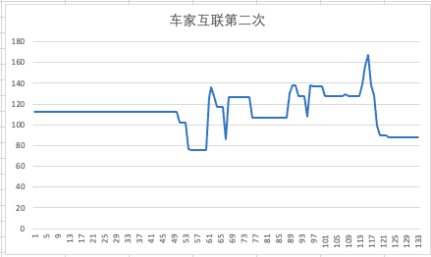
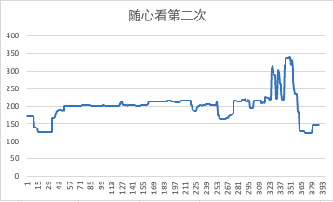
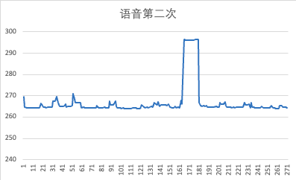
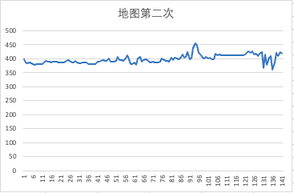
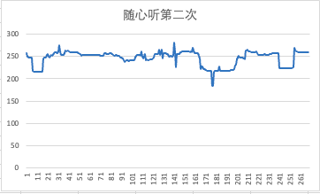
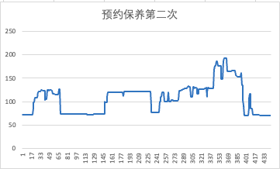
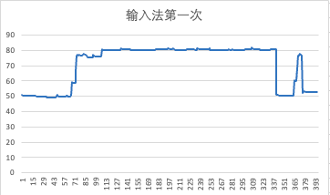
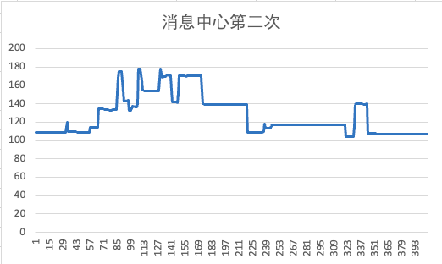
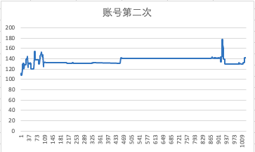
{CDX706L R5.1 Pro HF1} 内存泄露专项测试

Slide 5
{CDX706L R5.1 Pro HF1} 语音专项测试
唤醒词唤醒率：低配 Pass
场景化命令词识别率
AI能力 | 指标项 | 通过标准 | 实测结果 | 测试结论
暂停播放 | 低噪 | 85% | 98% | PASS
暂停播放 | 低噪 | 85% | 100% | PASS
 | 中噪 | 85% | 100% | PASS
 | 高噪 | 80% | 100% | PASS
继续播放 | 低噪 | 85% | 95% | PASS
 | 中噪 | 85% | 100% | PASS
 | 高噪 | 80% | 98% | PASS
上一首 | 低噪 | 85% | 95% | PASS
 | 中噪 | 85% | 90% | PASS
 | 高噪 | 80% | 85% | PASS
下一首 | 低噪 | 85% | 100% | PASS
 | 中噪 | 85% | 100% | PASS
 | 高噪 | 80% | 98% | PASS
上一曲 | 低噪 | 85% | 93% | PASS
 | 中噪 | 85% | 95% | PASS
 | 高噪 | 80% | 88% | PASS
下一曲 | 低噪 | 85% | 95% | PASS
 | 中噪 | 85% | 100% | PASS
 | 高噪 | 80% | 98% | PASS
接听电话 | 低噪 | 85% | 100% | PASS
 | 中噪 | 85% | 100% | PASS
 | 高噪 | 80% | 100% | PASS
挂断电话 | 低噪 | 85% | 100% | PASS
 | 中噪 | 85% | 100% | PASS
场景化命令词识别率
AI能力 | 指标项 | 通过标准 | 实测结果 | 测试结论
跟随模式 | 低噪 | 85% | 96% | PASS
跟随模式 | 低噪 | 85% | 95% | PASS
 | 中噪 | 85% | 100% | PASS
 | 高噪 | 80% | 100% | PASS
车头朝上 | 低噪 | 85% | 100% | PASS
 | 中噪 | 85% | 100% | PASS
 | 高噪 | 80% | 98% | PASS
正北模式 | 低噪 | 85% | 100% | PASS
 | 中噪 | 85% | 100% | PASS
 | 高噪 | 80% | 100% | PASS
放大地图 | 低噪 | 85% | 100% | PASS
 | 中噪 | 85% | 100% | PASS
 | 高噪 | 80% | 100% | PASS
缩小地图 | 低噪 | 85% | 100% | PASS
 | 中噪 | 85% | 100% | PASS
 | 高噪 | 80% | 100% | PASS
打开路况 | 低噪 | 85% | 100% | PASS
 | 中噪 | 85% | 100% | PASS
 | 高噪 | 80% | 100% | PASS
关闭路况 | 低噪 | 85% | 100% | PASS
 | 中噪 | 85% | 100% | PASS
 | 高噪 | 80% | 100% | PASS
开始导航 | 低噪 | 85% | 100% | PASS
 | 中噪 | 85% | 100% | PASS
场景化命令词识别率
AI能力 | 指标项 | 通过标准 | 实测结果 | 测试结论
查看全程 | 低噪 | 85% | 98% | PASS
查看全程 | 低噪 | 85% | 100% | PASS
 | 中噪 | 85% | 100% | PASS
 | 高噪 | 80% | 85% | PASS
继续导航 | 低噪 | 85% | 100% | PASS
 | 中噪 | 85% | 100% | PASS
 | 高噪 | 80% | 98% | PASS
上一页 | 低噪 | 85% | 100% | PASS
 | 中噪 | 85% | 95% | PASS
 | 高噪 | 80% | 93% | PASS
下一页 | 低噪 | 85% | 100% | PASS
 | 中噪 | 85% | 95% | PASS
 | 高噪 | 80% | 85% | PASS
确定 | 低噪 | 85% | 100% | PASS
 | 中噪 | 85% | 100% | PASS
 | 高噪 | 80% | 100% | PASS
取消 | 低噪 | 85% | 90% | PASS
 | 中噪 | 85% | 95% | PASS
 | 高噪 | 80% | 85% | PASS
第一个 | 低噪 | 85% | 95% | PASS
 | 中噪 | 85% | 100% | PASS
 | 高噪 | 80% | 98% | PASS
第二个 | 低噪 | 85% | 100% | PASS
 | 中噪 | 85% | 98% | PASS
 | 高噪 | 80% | 98% | PASS
第三个 | 低噪 | 85% | 95% | PASS
 | 中噪 | 85% | 100% | PASS
唤醒词唤醒率
AI能力 | 指标项 | 通过标准 | 实测结果 | 测试结论
小度小度 | 低噪 | 92% | 100% | PASS
 | 中噪 | 90% | 96% | PASS
 | 高噪 | 85% | 100% | PASS
你好福特 | 低噪 | 92% | 100% | PASS
 | 中噪 | 90% | 100% | PASS
 | 高噪 | 85% | 98% | PASS

Slide 6
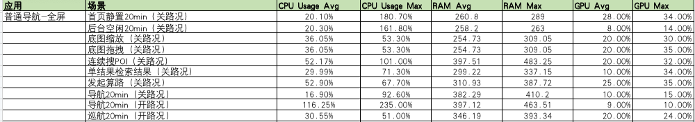
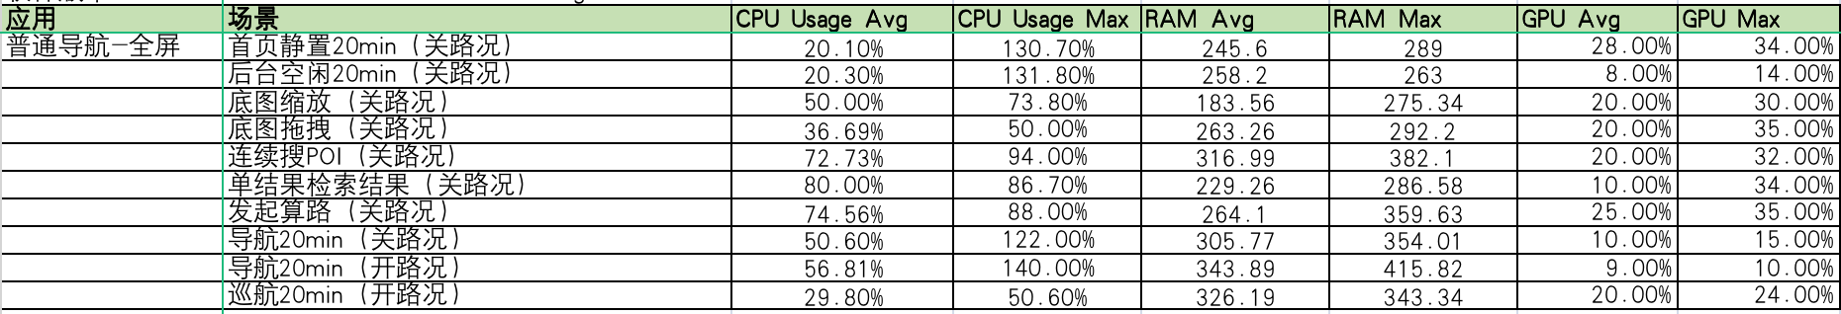
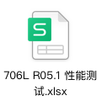
{CDX706L R5.1 Pro HF1} 性能专题测试
CDX706L R5.1 Pro
CDX706L R5.1 Pro HF1

Slide 7
{CX706H_R5.1 Pro HF1} Software overall status {yellow}
20220602_0708_GF13_R05.1.PRO
Software key info
Refer SWAD for the details:
MCU version: 20220518_447_PRO
SoC User version: 20220524_0699_FF27_R05.1.PRO
Verification scope and method:
{Full verification} executed with pass rate 98%, 0 P1 and 33 P2 issues found and not fixed and 33 P2 issues in Verfication . Refer test report for detail.
Main changes compared with previous version, refer RN for the details, highlights listed below:
Non-compliance issue list, refer attached file for detail, P1 issues listed below:
APIMCIS_xxxxxx
……
Open new feature state list – refer slide 3
Open AIMS with risk evaluation – refer slide 4
Notes:
Add P1 weekly burn down chart

Slide 8
{CDX706H R5.1 Pro HF1} Open IG with risk evaluation
Key | Summary | Priority | AIMS # | Remark
AW2-3710 | 【706L/H】【必现】【爱奇艺】爱奇艺无法播放 | IG |  | 和德赛ECG同事定位到是ECG2 内部网络请求缓慢，需要ECG同学重新发版解决
Notes:
Add P1 weekly burn down chart

Slide 9
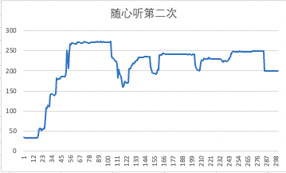
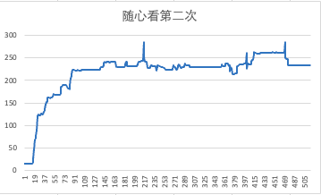
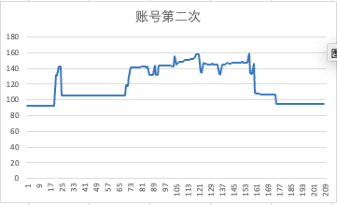
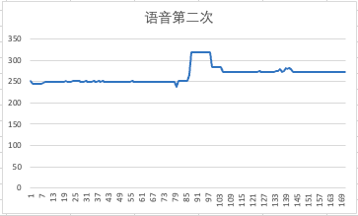
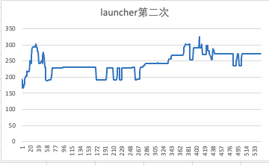
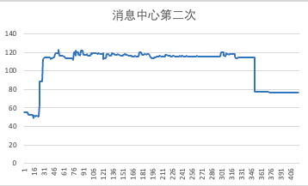
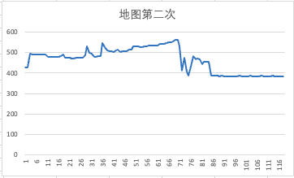
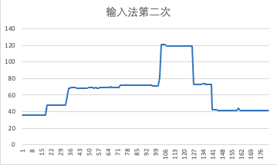
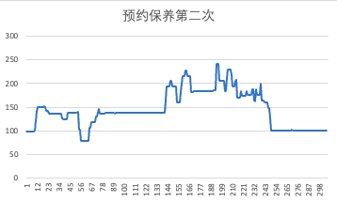
{CDX706H R5.1 Pro HF1} 性能专项测试

Slide 10
{CDX706H R5.1 Pro HF1} 语音专项测试
唤醒词唤醒率：高配 Pass
场景化命令词识别率
AI能力 | 指标项 | 通过标准 | 实测结果 | 测试结论
暂停播放 | 低噪 | 85% | 100% | PASS
 | 中噪 | 85% | 100% | PASS
 | 高噪 | 80% | 100% | PASS
继续播放 | 低噪 | 85% | 100% | PASS
 | 中噪 | 85% | 100% | PASS
 | 高噪 | 80% | 99% | PASS
上一首 | 低噪 | 85% | 100% | PASS
 | 中噪 | 85% | 95% | PASS
 | 高噪 | 80% | 88% | PASS
下一首 | 低噪 | 85% | 100% | PASS
 | 中噪 | 85% | 98% | PASS
 | 高噪 | 80% | 98% | PASS
上一曲 | 低噪 | 85% | 100% | PASS
 | 中噪 | 85% | 98% | PASS
 | 高噪 | 80% | 86% | PASS
下一曲 | 低噪 | 85% | 98% | PASS
 | 中噪 | 85% | 100% | PASS
 | 高噪 | 80% | 96% | PASS
接听电话 | 低噪 | 85% | 98% | PASS
 | 中噪 | 85% | 95% | PASS
 | 高噪 | 80% | 100% | PASS
挂断电话 | 低噪 | 85% | 100% | PASS
 | 中噪 | 85% | 98% | PASS
 | 高噪 | 80% | 93% | PASS
场景化命令词识别率
AI能力 | 指标项 | 通过标准 | 实测结果 | 测试结论
跟随模式 | 低噪 | 85% | 100% | PASS
 | 中噪 | 85% | 100% | PASS
 | 高噪 | 80% | 100% | PASS
车头朝上 | 低噪 | 85% | 100% | PASS
 | 中噪 | 85% | 100% | PASS
 | 高噪 | 80% | 95% | PASS
正北模式 | 低噪 | 85% | 95% | PASS
 | 中噪 | 85% | 100% | PASS
 | 高噪 | 80% | 98% | PASS
放大地图 | 低噪 | 85% | 100% | PASS
 | 中噪 | 85% | 100% | PASS
 | 高噪 | 80% | 94% | PASS
缩小地图 | 低噪 | 85% | 100% | PASS
 | 中噪 | 85% | 98% | PASS
 | 高噪 | 80% | 95% | PASS
打开路况 | 低噪 | 85% | 100% | PASS
 | 中噪 | 85% | 100% | PASS
 | 高噪 | 80% | 100% | PASS
关闭路况 | 低噪 | 85% | 100% | PASS
 | 中噪 | 85% | 100% | PASS
 | 高噪 | 80% | 100% | PASS
开始导航 | 低噪 | 85% | 100% | PASS
 | 中噪 | 85% | 100% | PASS
 | 高噪 | 80% | 90% | PASS
场景化命令词识别率
AI能力 | 指标项 | 通过标准 | 实测结果 | 测试结论
查看全程 | 低噪 | 85% | 100% | PASS
 | 中噪 | 85% | 98% | PASS
 | 高噪 | 80% | 98% | PASS
继续导航 | 低噪 | 85% | 100% | PASS
 | 中噪 | 85% | 100% | PASS
 | 高噪 | 80% | 98% | PASS
上一页 | 低噪 | 85% | 96% | PASS
 | 中噪 | 85% | 100% | PASS
 | 高噪 | 80% | 90% | PASS
下一页 | 低噪 | 85% | 95% | PASS
 | 中噪 | 85% | 95% | PASS
 | 高噪 | 80% | 95% | PASS
确定 | 低噪 | 85% | 100% | PASS
 | 中噪 | 85% | 100% | PASS
 | 高噪 | 80% | 98% | PASS
取消 | 低噪 | 85% | 100% | PASS
 | 中噪 | 85% | 98% | PASS
 | 高噪 | 80% | 90% | PASS
第一个 | 低噪 | 85% | 100% | PASS
 | 中噪 | 85% | 100% | PASS
 | 高噪 | 80% | 98% | PASS
第二个 | 低噪 | 85% | 90% | PASS
 | 中噪 | 85% | 98% | PASS
 | 高噪 | 80% | 93% | PASS
第三个 | 低噪 | 85% | 98% | PASS
 | 中噪 | 85% | 100% | PASS
 | 高噪 | 80% | 93% | PASS
唤醒词唤醒率
AI能力 | 指标项 | 通过标准 | 实测结果 | 测试结论
小度小度 | 低噪 | 92% | 98% | PASS
 | 中噪 | 90% | 94% | PASS
 | 高噪 | 85% | 93% | PASS
你好福特 | 低噪 | 92% | 100% | PASS
 | 中噪 | 90% | 100% | PASS
 | 高噪 | 85% | 96% | PASS

Slide 11
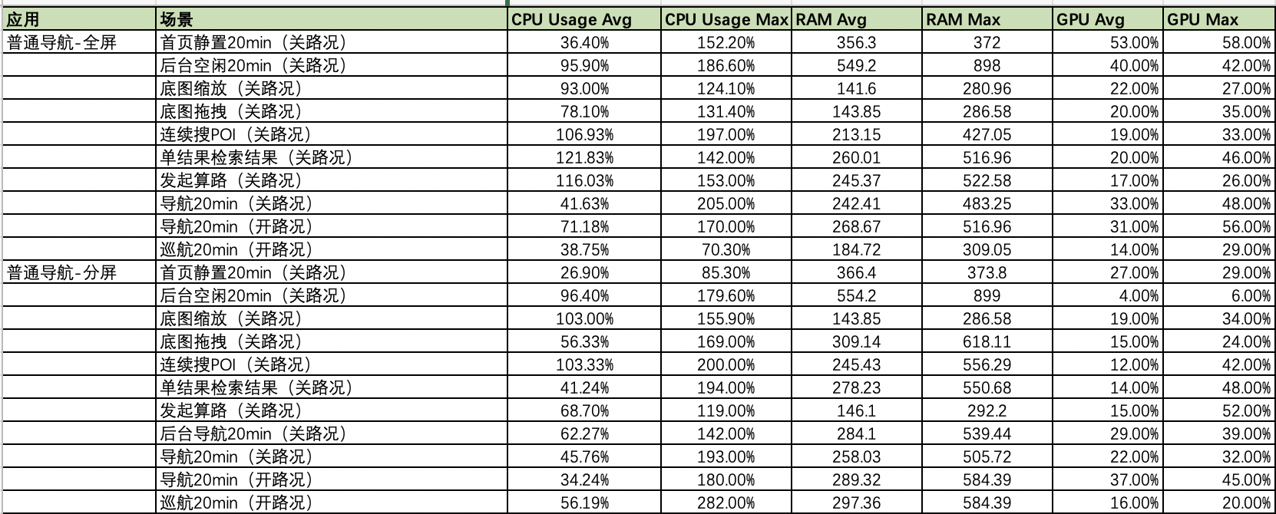
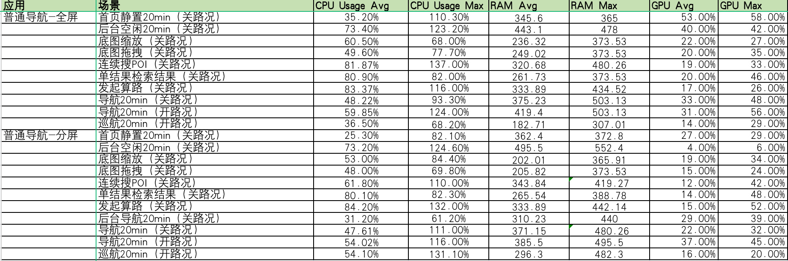

{CDX706H R5.1 Pro HF1} 性能专题测试
CDX706H R5.1 Pro
CDX706H R5.1 Pro HF1

